Slide 1

PERIODICITY
TRENDS IN THE PERIODIC TABLE (2)

Slide 2
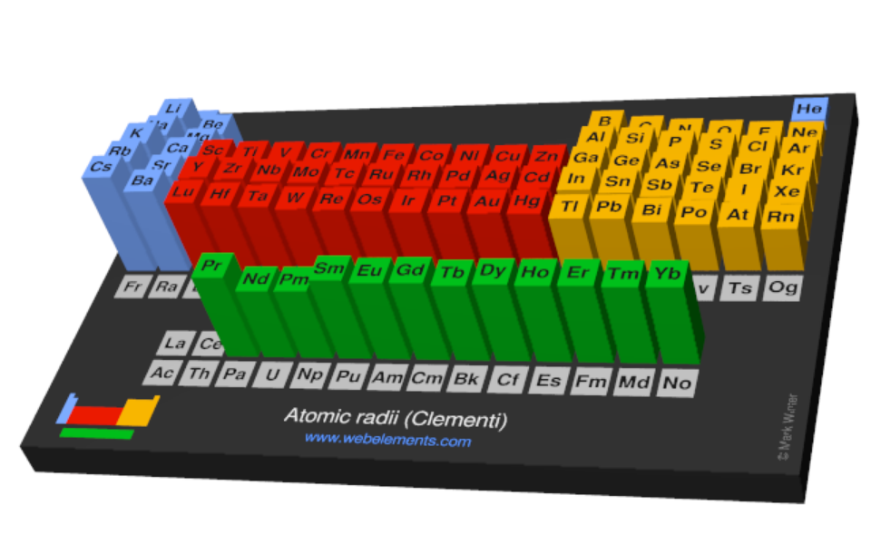
INQUIRY INTO THE TRENDS
Explore the trends in the Periodic table:
Atomic radius
First Ionisation energy
Electronegativity

Slide 3
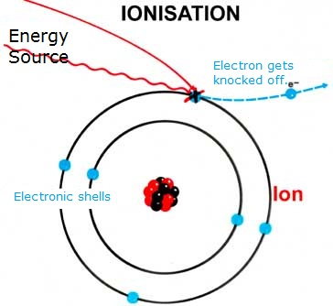
2. FIRST IONISATION ENERGY
Ionisation energy is the energy required to remove one of the loosely held outermost electron
The first Ionisation energy is the energy required to remove ONE mole of electrons from ONE mole of the gaseous atom (or ion)
M + Energy → M⁺ + e⁻
Na_{(g)} + E₁ → Na⁺_{(g)} + e⁻
E₁ represents the first ionisation energy

Slide 4
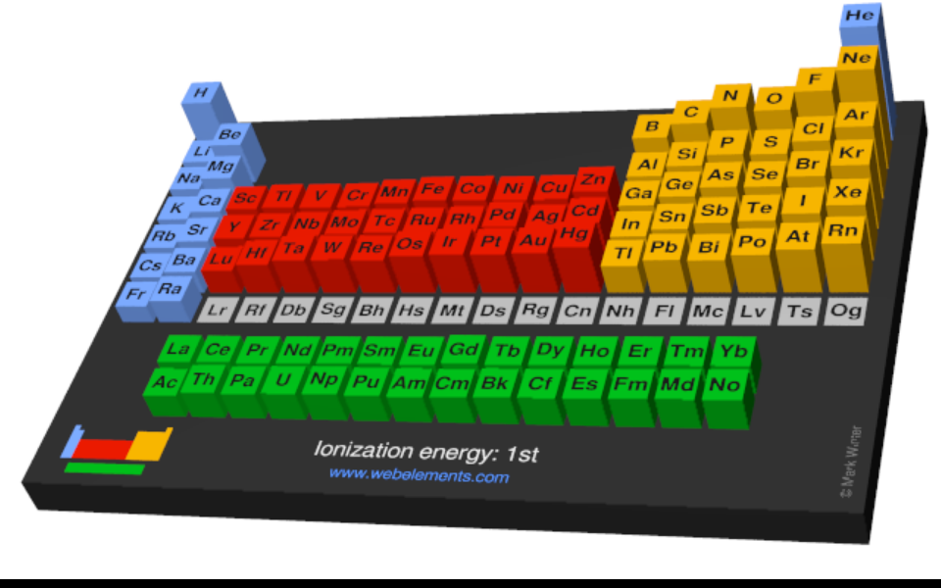
2. FIRST IONISATION ENERGY
What is the trend:
Down a group?
Across a period?
Through the table as a whole?
Reference: https://www.webelements.com/periodicity/ionis_energy_1/

Slide 5
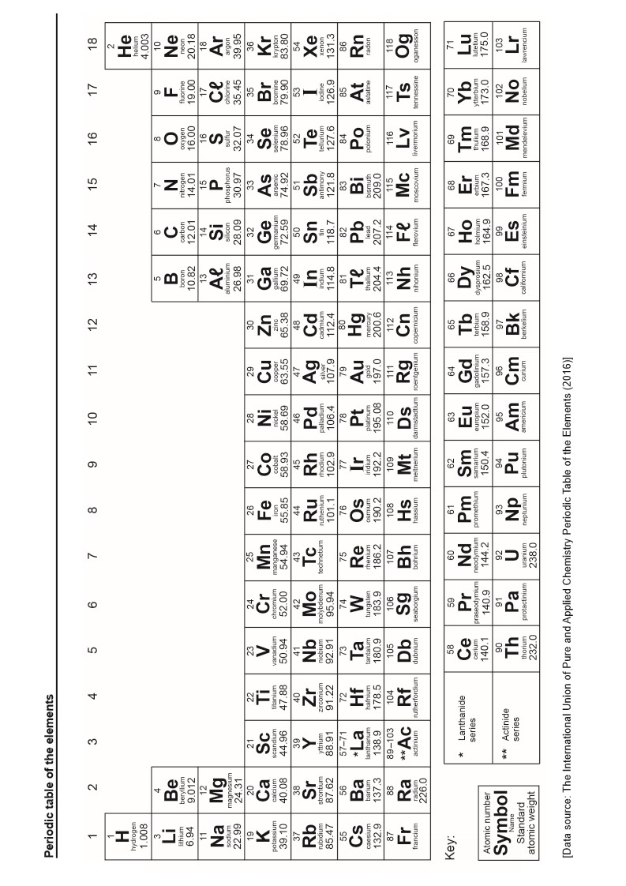
2. FIRST IONISATION ENERGY
Ionisation energy increasing
Ionisation energy decreasing

Slide 6
2. FIRST IONISATION ENERGY
Ionisation Energy is directly related to Atomic radii. This is because the energy is used to remove an electron, from the outer shell of the atom, must overcome its attraction to the nucleus, and this is related to its distance away (radius).
As with Atomic radii we need to consider two concepts:
Principal Quantum Number (n)
Effective nuclear charge (Z_{eff})
These two factors can be used to explain the observed Periodic Trend.

Slide 7
2. FIRST IONISATION ENERGY
Group Trend – As you go down a column, ionization energy decreases
Period Trend – As you go across a period (L to R), ionization energy increases
Table Trend – As you go bottom right to top left (diagonal), ionization energy increases

Slide 8
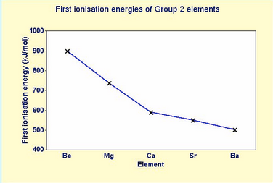
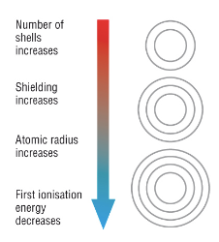
2. FIRST IONISATION ENERGY
Group Trend – As you go down a column, ionization energy decreases
As you go down, atomic radius is increasing (due to adding shells, n), this increases the distance so lowering the attraction and making it easier to remove an e⁻
the shielding effect is also greater as you go down a group

Slide 9
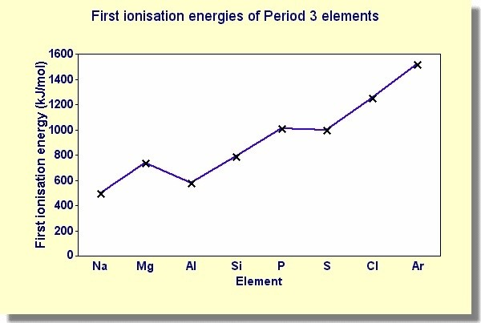
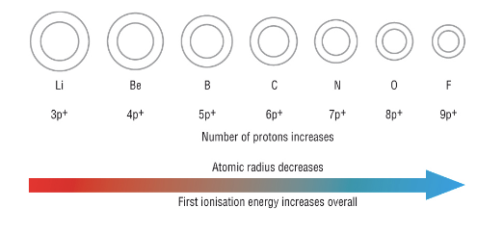
2. FIRST IONISATION ENERGY
Period Trend – As you go across a period (L to R), ionization energy increases
As you go L to R, atomic radius is decreasing (more attraction), so more difficult to remove an e⁻
As you go L to R, effective nuclear charge is increasing (more protons with same number of core electrons) so the valence electrons are more attracted making it is more difficult to remove an e⁻

Slide 10
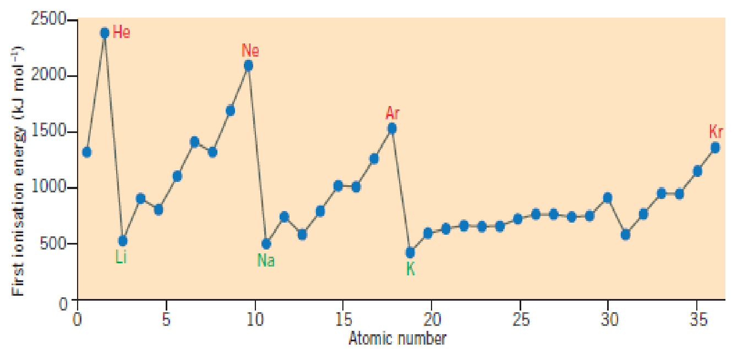
2. FIRST IONISATION ENERGY
It is possible to represent this trend as a graph of First ionisation energy vs atomic number
Trend 1: Ionisation energy increases from L to R in a period seen here with Li to Ne
Trend 2: Ionisation energy decreases down a group as seen here with He to Ne to Ar

Slide 11
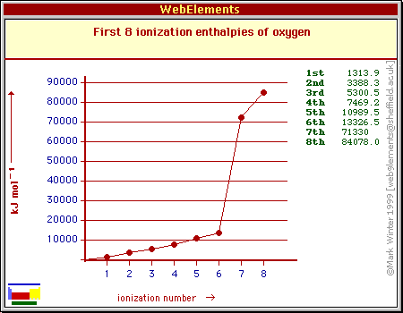
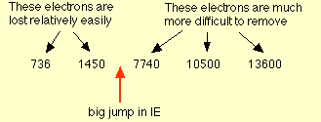
HIGHER LEVEL IONISATION ENERGY
What if I take off several electrons in successive ionisations?
Why is there a general rise for the first 6
Why is there such a jump for the 7th
Example: Magnesium has an electron configuration of 2,8,2
The first 2 electrons are easy to take off, the third one is a core electron so is much harder (it is closer to the nucleus so attraction is higher)

Slide 12
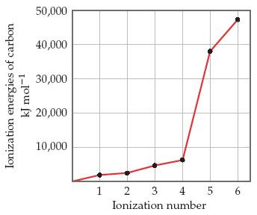
HIGHER LEVEL IONISATION ENERGY
What group is this element in?
Easy to remove first 4 electrons then a big jump to remove the 5th.
So it must be in Group 14

Slide 13
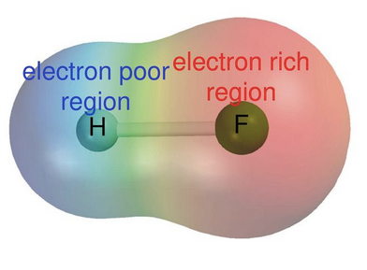
3. ELECTRONEGATIVITY
Electronegativity is a relative scale of the ability of an atom to attract the shared electrons in a molecule.
It has no units and is a relative scale that compares elements to a baseline (hydrogen).
The more electronegative an element is the more strongly it can pull the shared electrons towards itself in a covalent bond. (that is to polarise the electron density towards itself)

Slide 14
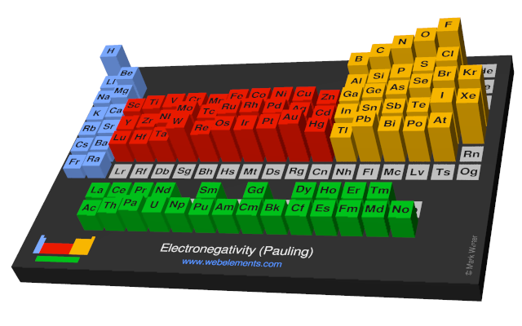
3. ELECTRONEGATIVITY
What is the trend:
Down a group?
Across a period?
Through the table as a whole?

Slide 15
3. ELECTRONEGATIVITY
Electronegativity increasing
Electronegativity decreasing

Slide 16
3. ELECTRONEGATIVITY
Group Trend – As you go down a column, electronegativity decreases
Period Trend – As you go across a period (L to R), electronegativity increases
Most noble gases are not included as they do not naturally form covalent bonds

Slide 17
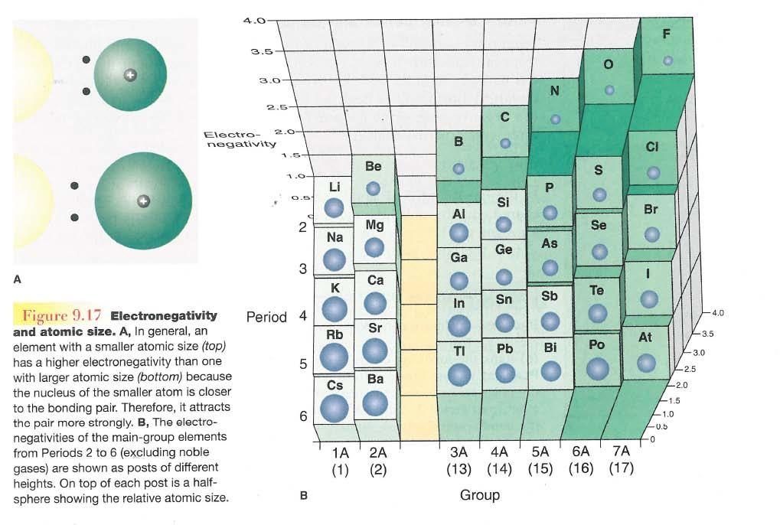
3. ELECTRONEGATIVITY
Group Trend – As you go down a column, electronegativity decreases
As you go down, atomic size is increasing, so less attraction to its own e⁻ and other atom’s e⁻
Period Trend – As you go across a period (L to R), electronegativity increases
As you go L to R, atomic size is decreasing, so there is more attraction to its own e⁻ and other atom’s e⁻

Slide 18
3. ELECTRONEGATIVITY
In general, an atoms electronegativity is inversely related to its size.
The ability to draw the shared electrons closer will be stronger if:
they are closer (ie smaller atomic radii)
Have a larger nuclear charge.

Slide 19
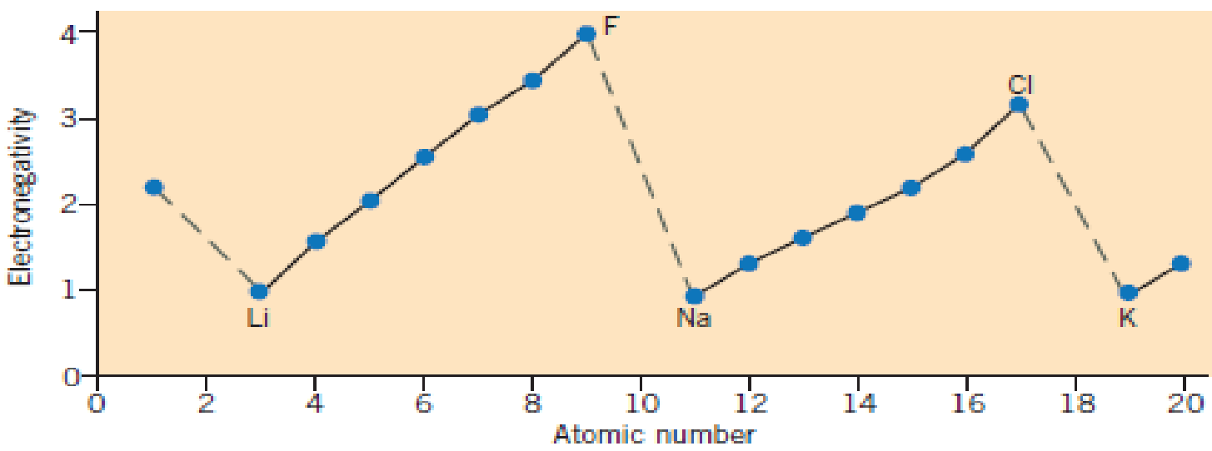
3. ELECTRONEGATIVITY
It is possible to represent this trend as a graph of Electronegativity vs atomic number
Trend 1: Electronegativity increases from L to R in a period seen here with Li to F
Trend 2: Electronegativity decreases down a group as seen here with F to Cl

Slide 20
REACTIVITY
Reactivity – tendency of an atom to react
Metals – lose e⁻ when they react, so metals’ reactivity is based on lowest Ionization Energy (bottom/left corner)
Low Ionisation Energy = High Reactivity
Nonmetals – gain e⁻ when they react, so nonmetals’ reactivity is based on high electronegativity (upper/right corner)
High electronegativity = High reactivity

Slide 21
METALLIC CHARACTER
Group Trend – As you go down a group, metallic character increases
Periodic Trend – As you go across a period (L to R), metallic character decreases (L to R, you are going from metals to non-metals

Slide 22
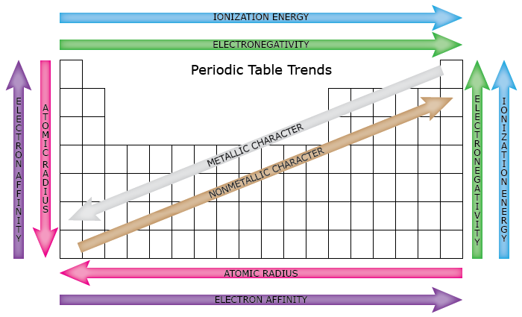
SUMMARY

